Slide 1
GTD Book2
File created on: 12/5/2024 3:27:01 AM

Slide 2
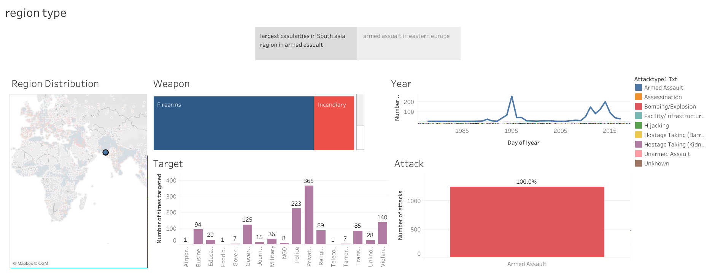

Slide 3
